Slide 1
NMO Clinical Trial Webinar update

Slide 2
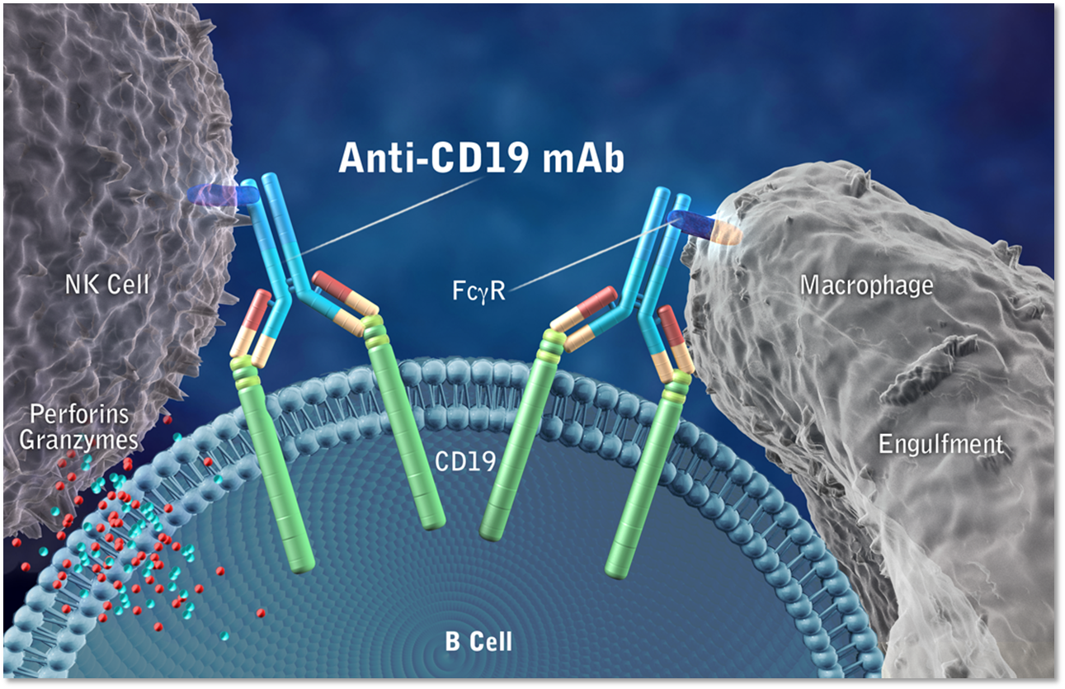
Inebilizumab, an anti-CD19 monoclonal antibody: how does it work?
Inebilizumab
ADCC

Slide 3
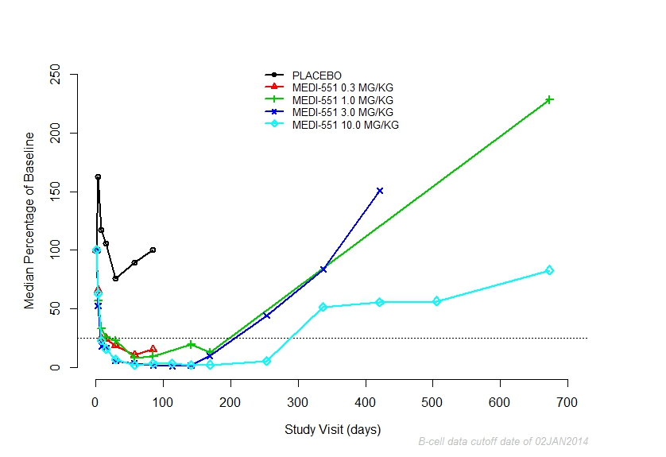
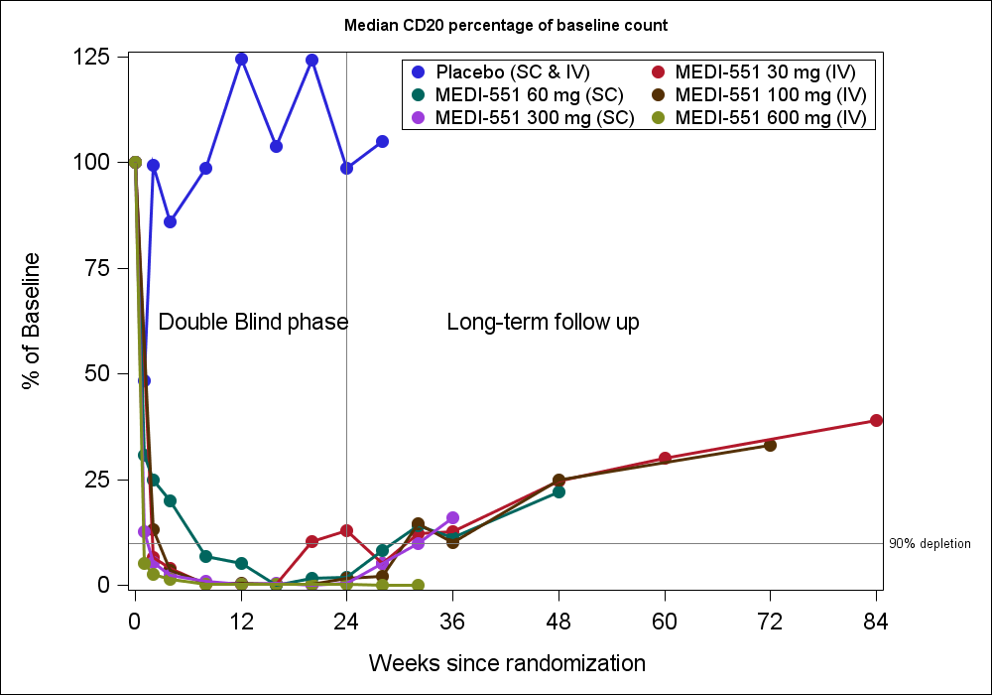
Inebilizumab: previous clinical experience
Multiple Sclerosis
Phase 1 trial – effect on B-cells
Scleroderma Phase 1 trial – effect on B-cells

Slide 4
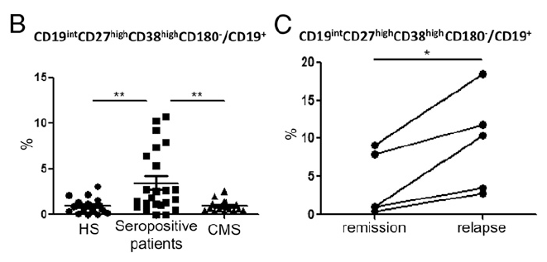
Inebilizumab targets a broader spectrum of B cells
B-cell development
Inebilizumab
Rituximab
Adapted from: von Büdingen HC, et al. European Neurology 2015;73:238–246.
Notes:
Chihara et al. in 2010 looked at proportional changes in B subsets in seropositive NMO subjects and found that there was a remarkable expansion of B cell subsets in subjects with NMO compared to healthy subjects and MS. The expansion of this subset of B cells corresponded to CD19 subsets of plasma cells that were increased in NMO/NMOSD and, moreover, this subset of B cells was increased in the same subjects during relapse. He also was able to determine that these PB were capable of producing AQP4-IgG.

Slide 5
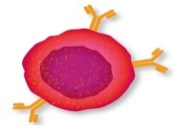
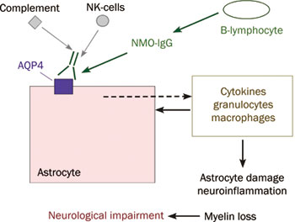
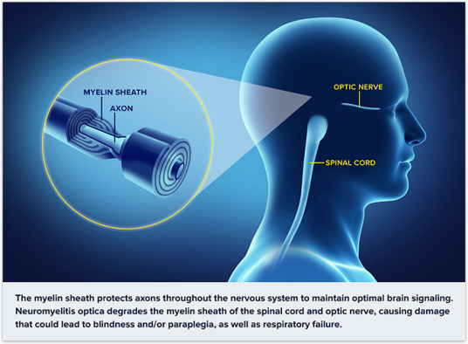
Inebilizumab: NMO scientific rationale
NMO Pathogenesis
B cells have important roles in the pathogenesis of autoimmune diseases, including NMO
CD19 B cells produce anti-AQP4 autoantibodies
CD-19 B cells
Neurological impairment
5

Slide 6
Inebilizumab: mechanism of action and B-cell depletion in NMO
Inebilizumab
CD-19 B cell
Neurological impairment

Slide 7
N-MOmentum: a double-masked, placebo-controlled study in adult subjects with NMO/NMOSD
28 weeks
4 weeks
Inebilizumab (3)
28 weeks
Screening
period
Open-label
period
Randomized control period
Placebo (1)
Primary endpoint:
Time to new or worsening NMO attack
Randomization:
3:1

Slide 8
Key eligibility criteria
Inclusion criteria:
Men and women 18 years or older with diagnosis of NMO/NMOSD
Seropositive or seronegative NMO/NMOSD patients with at least one attack in 1 year or two attacks in the last 2 years requiring rescue therapy prior to randomization
EDSS ≤7.5
(please visit https://clinicaltrials.gov/ct2/show/NCT02200770?term=NMO&rank=8 for the complete list of the inclusion/exclusion criteria)

Slide 9
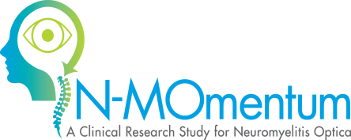
Key eligibility criteria (continued)
Exclusion Criteria:
Lactating and pregnant females
Known history of severe allergic reaction or anaphylaxis after any biologic therapy
Known active severe bacterial, fungal, or viral infection or any major episode of infection requiring hospitalization
NMO patients diagnosed with a concurrent autoimmune disease requiring immunosuppressive agents
History of cancer, apart from squamous cell or basal cell carcinoma of the skin with documented success of curative therapy
Receipt of rituximab in the last 6 months, B-cell counts within normal limits

Slide 10
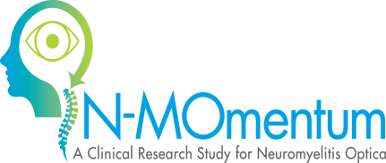
Medications
Immunosuppressant therapy after randomization is not permitted
Protocol mandates two weeks of 20 mg/day of prednisone followed by one week of tapering in randomized period only
Required: Infusion related reaction prophylaxis:
IV methylprednisolone (steroids)
Benadryl
Tylenol
Rescue medications allowed
Concomitant medications: non-NMO related medications may be allowed

Slide 11
Study Details
9 Randomized controlled period visits
Physical/neurological examination
Vitals signs, blood/urine collection
Assessment of adverse events
EDSS and ophthalmology examination at visit day 1, 85 and 197
MRI at visit day 197
Screening visit
AQP4-IgG sero-status
Physical/neurological examination
Vitals signs, ECG, Blood /urine collection
EDSS and ophthalmology examination
MRI
Attack visit
Physical/neurological examination
Vitals signs, blood/urine collection
EDSS and ophthalmology examination
MRI

Slide 12
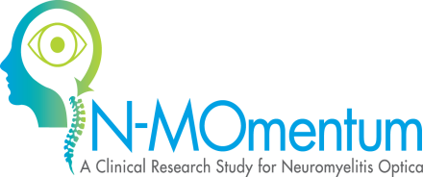
Beyond the randomized controlled period
Inebilizumab (3)
Open-label period
(inebilizumab only)
Screening:
28 days
Randomized controlled period: 6.5 months
Placebo (1)
Safety follow-up period
Randomization
3:1
Open-label period:
Gather safety data for an extended period
Opportunity for patient to receive a B-cell–depleting agent with continued medical care
Minimum for 1 year, maximum for 3 years, or until local approval
Safety follow-up period:
All about B-cell recovery
Follow up for 12 months after last dose of inebilizumab

Slide 13
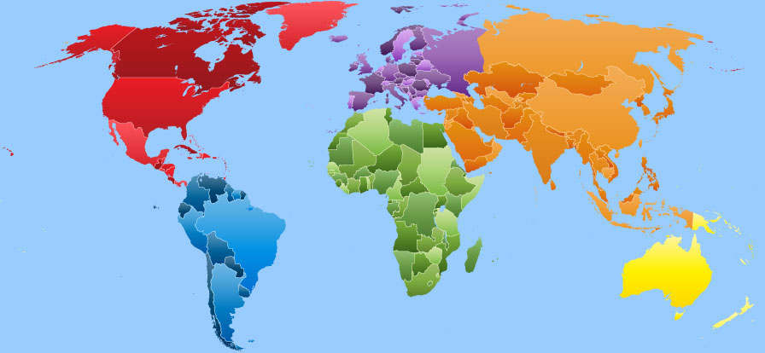
Inebilizumab NMOSD Trial Participating Countries – Jan 2017
Bulgaria
Spain
Czech Republic,
Estonia,
Germany,
Poland
Russia
Moldova
Israel,
South Africa
Turkey
Greece
Hungary
Portugal
Serbia
Canada
USA
Hong Kong
Japan
South Korea
Taiwan
Thailand
Brazil
Colombia
Mexico
Peru
Australia
New Zealand
Target
252 subjects;
67 adjudicated attacks
Recruitment progressing well
Focus to complete recruitment asap
107 sites activated
28 countries
13
Notes:
21 of 25 countries active
118 sites selected
74 sites activated (63%)
30 sites recruiting in 14 countries
PPD target for Aug = 92 SIVs (78%)
Currently estimate only 78

Slide 14
THANKS!

